Slide 1
Introduction to Image Analysis
3D image segmentation and measurements
Robert Haase, Benoit Lombardot
Contents
Segmentation in Fiji
Segmentation in Imaris
Measurements in 3D images

Slide 2
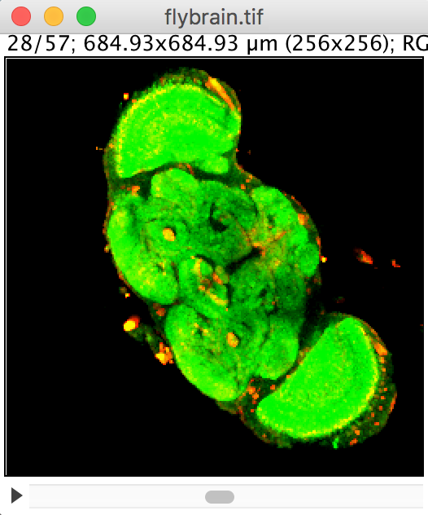
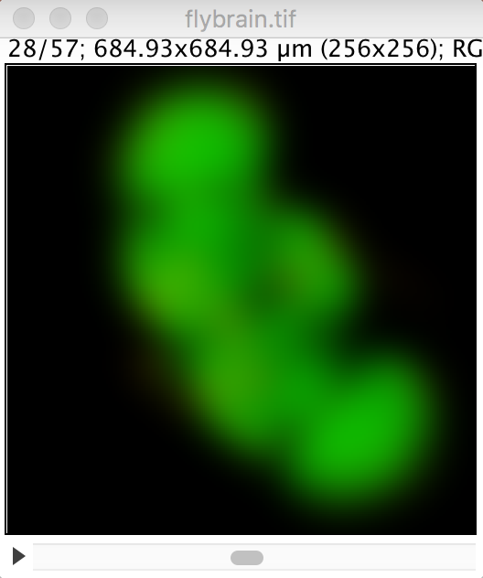
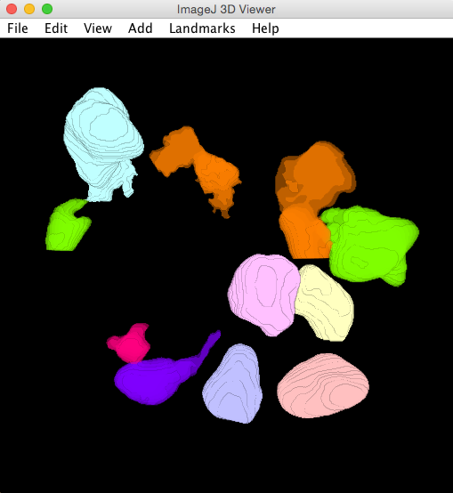
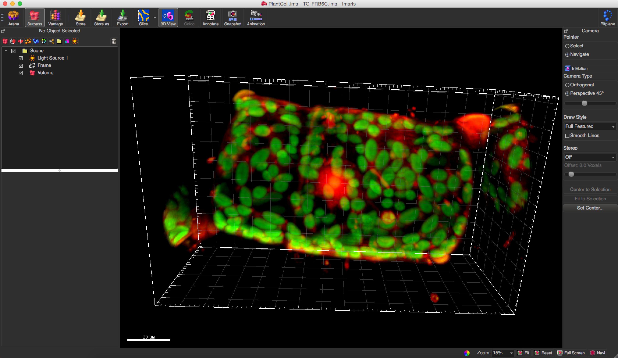
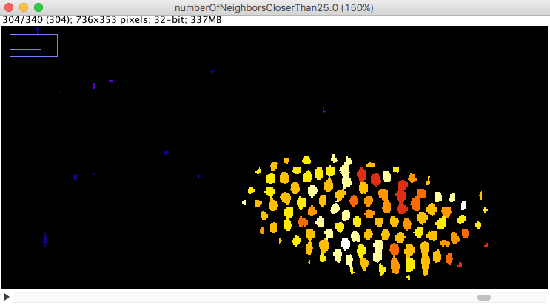
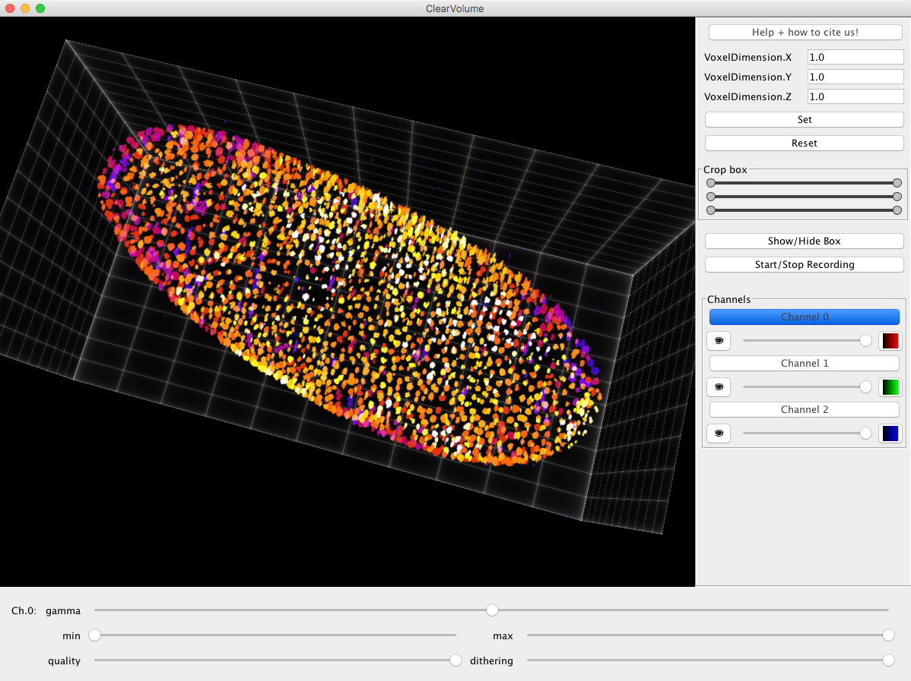
Overview
3D image segmentation and measurements
Filtering in 3D
Gaussian blur
Segmentation in Fiji
HMaxima
Watershed
Volume manager
Exercise
Segmentation in Imaris
Demo
Measurements in Fiji
Label analyser
Constraint label maps
Exercise
0
11

Slide 3
Introduction
3D image segmentation and measurements
Algorithms for 3D image segmentation are mostly the same like in 2D processing.
Filters (Gaussian blur, image subtraction,...)
Segmentation (thresholding, watershed, ...)
Measurements (area → volume, circularity → sphericity)
However,
configuration may be more complicated (Anisotropy),
the 3D tools may have different names in Fiji menus,
3D processing takes more time and
consumes more memory.

Slide 4
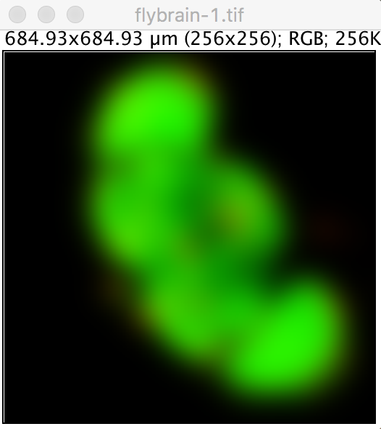
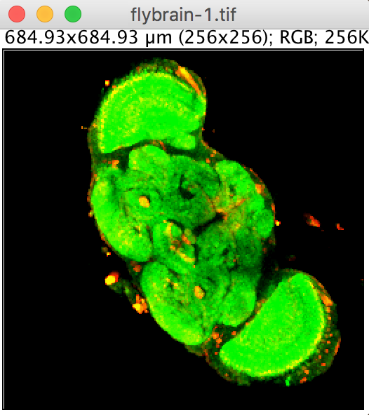
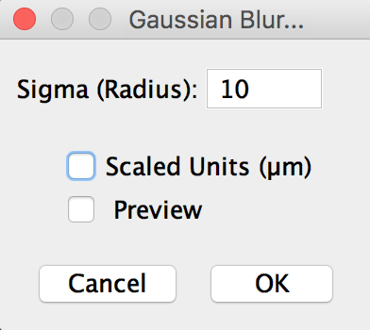
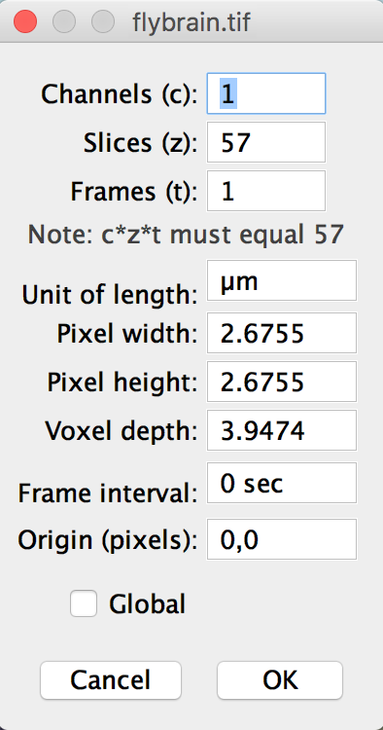

Filters: Gaussian blur in 2D
3D image segmentation and measurements
Process > Filters > Gaussian blur

Slide 5
Filters: Gaussian blur in 2D
3D image segmentation and measurements
Process > Filters > Gaussian blur
x

Slide 6
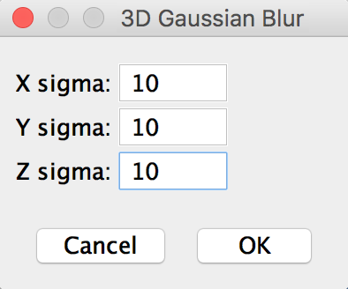
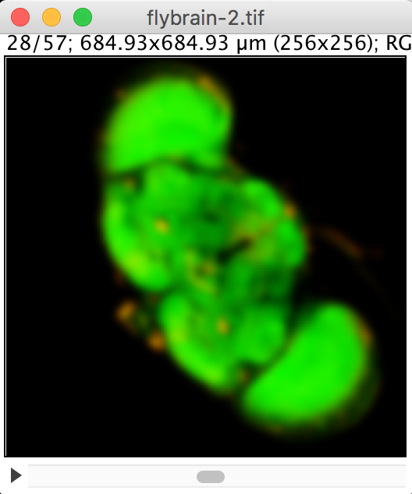
Filters: Gaussian blur in 3D
3D image segmentation and measurements
Process > Filters > Gaussian blur 3D

Slide 7
Quiz
3D image segmentation and measurements
Process > Filters > Gaussian blur 3D
Voxel units
Does it work with physical units or with voxel units?
Physical units
Physical units
Voxel units

Slide 8
Overview
3D image segmentation and measurements
Filtering in 3D
Gaussian blur
Segmentation in Fiji
HMaxima
Watershed
Volume manager
Exercise
Segmentation in Imaris
Demo
Measurements in Fiji
Label analyser
Constraint label maps
Exercise
0
11

Slide 9
Segmentation in 3D
3D image segmentation and measurements
Similar algorithms like in 2D
Thresholding,
Local maxima detection,
Watershed
Higher computational costs
Memory
Time
Inspection / reviewing is more complicated
2D computer screen

Slide 10
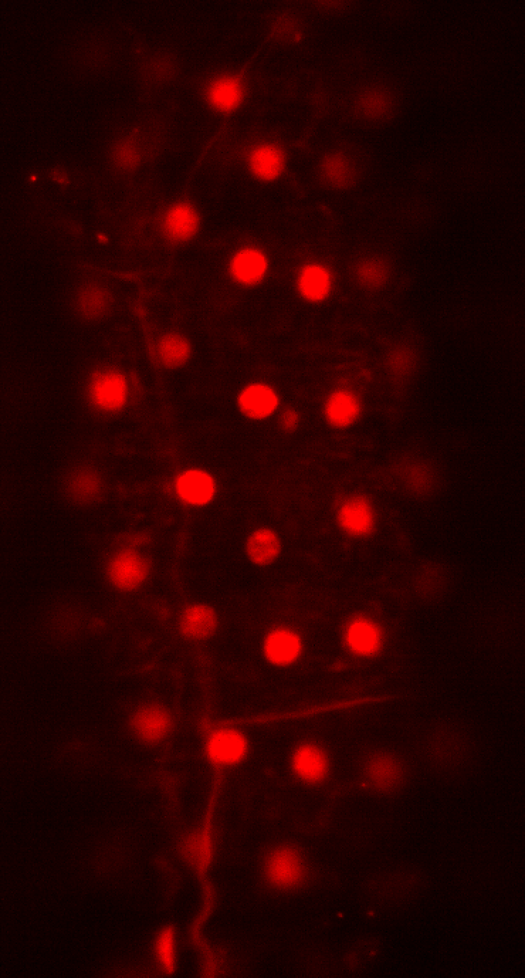
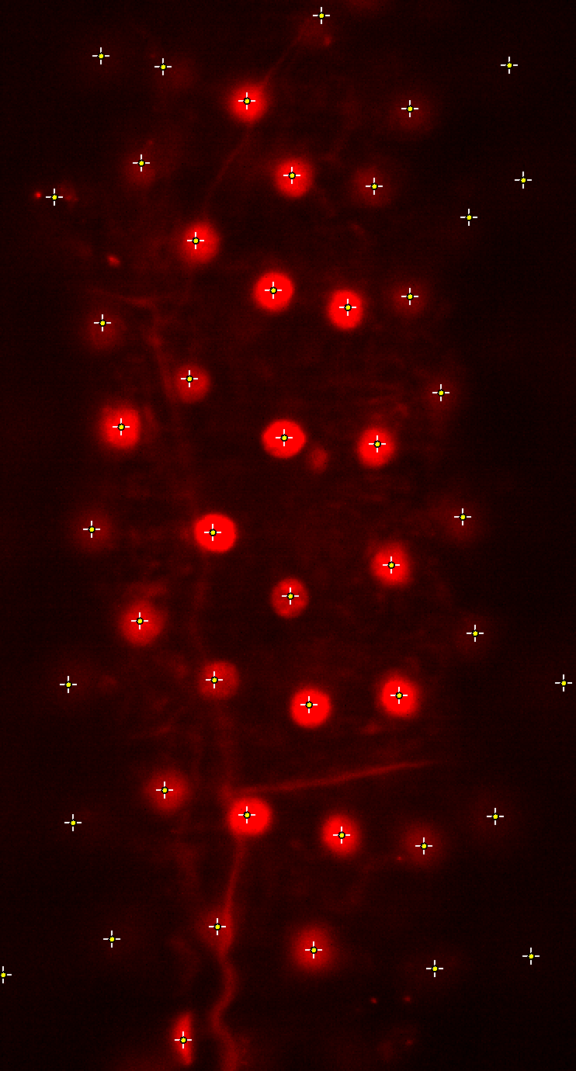
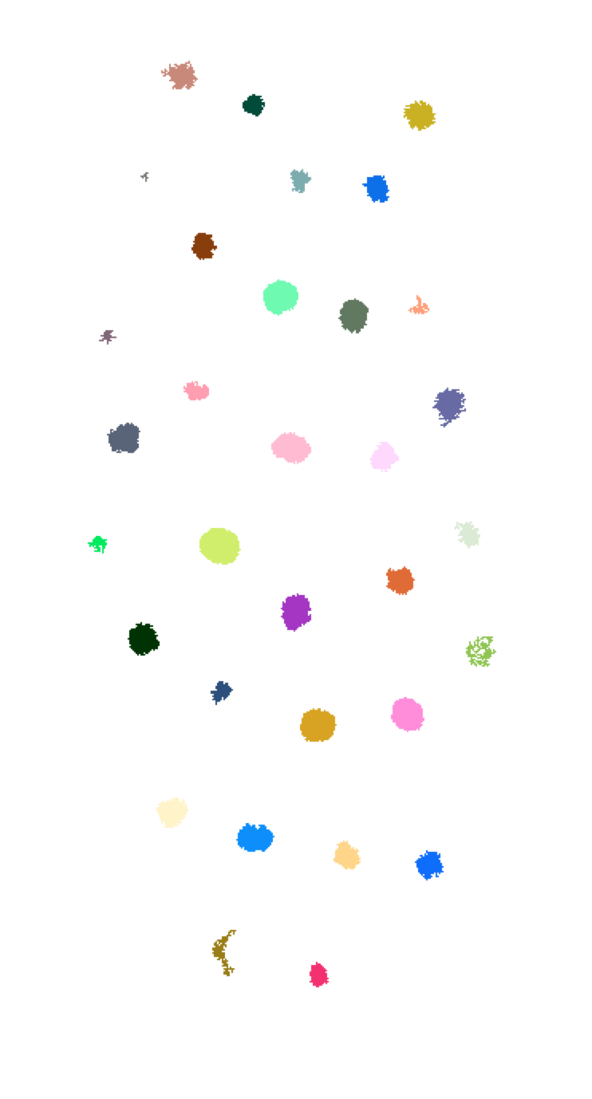
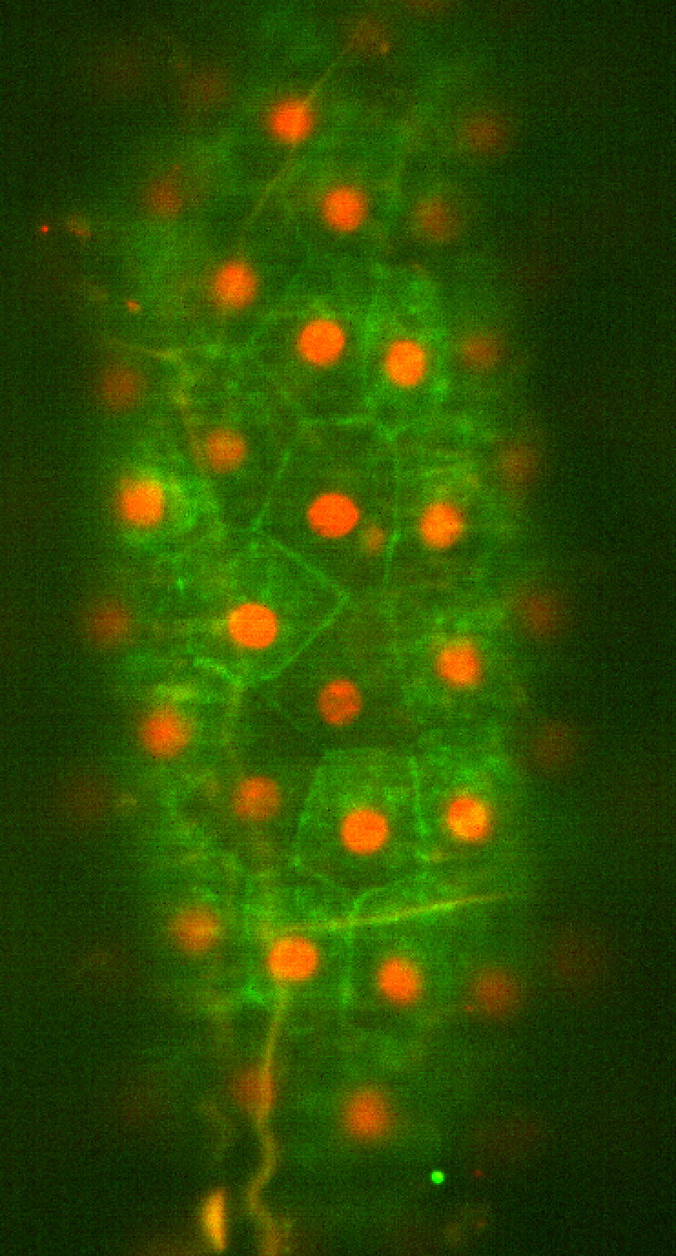
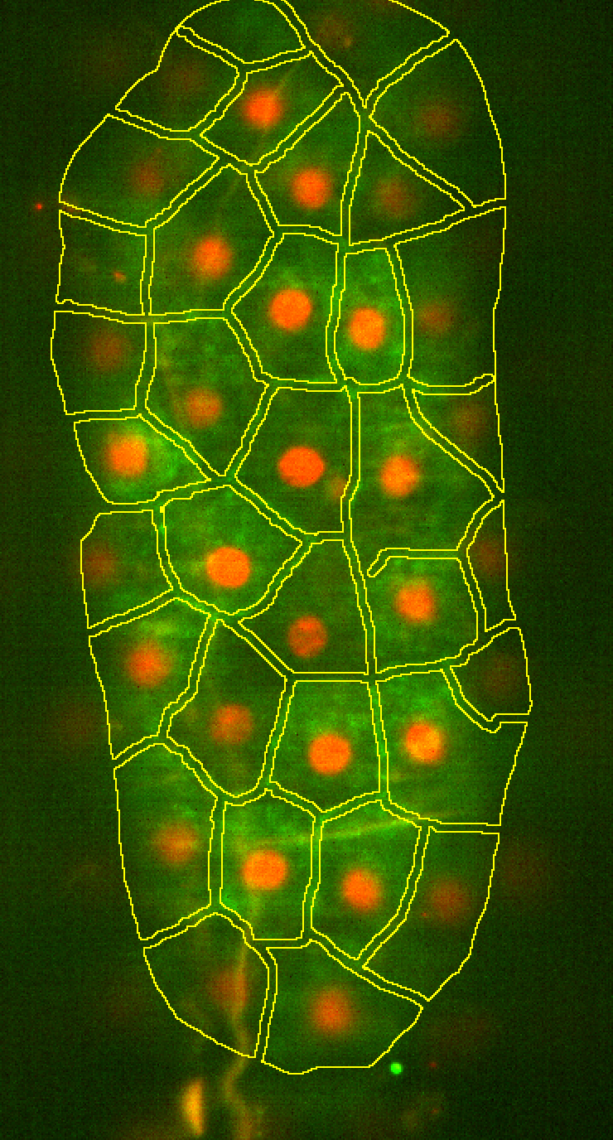
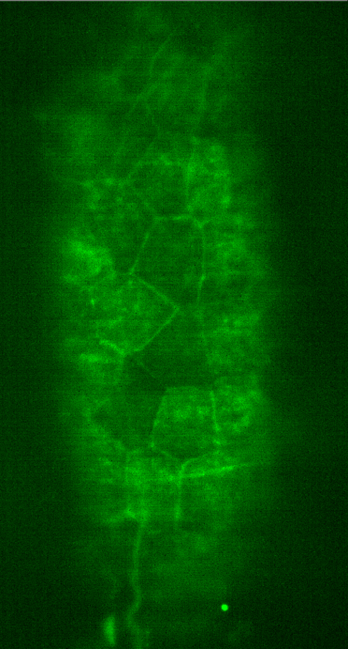
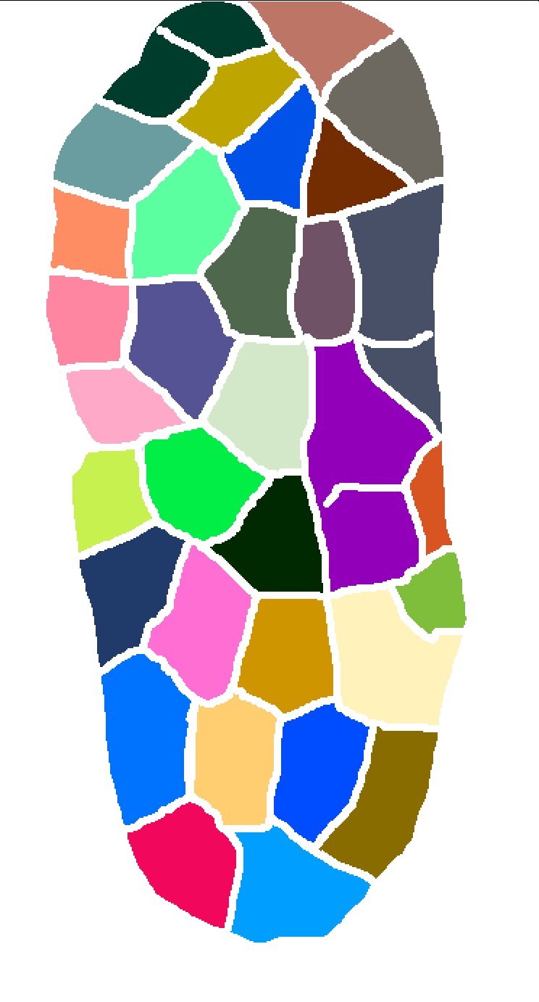
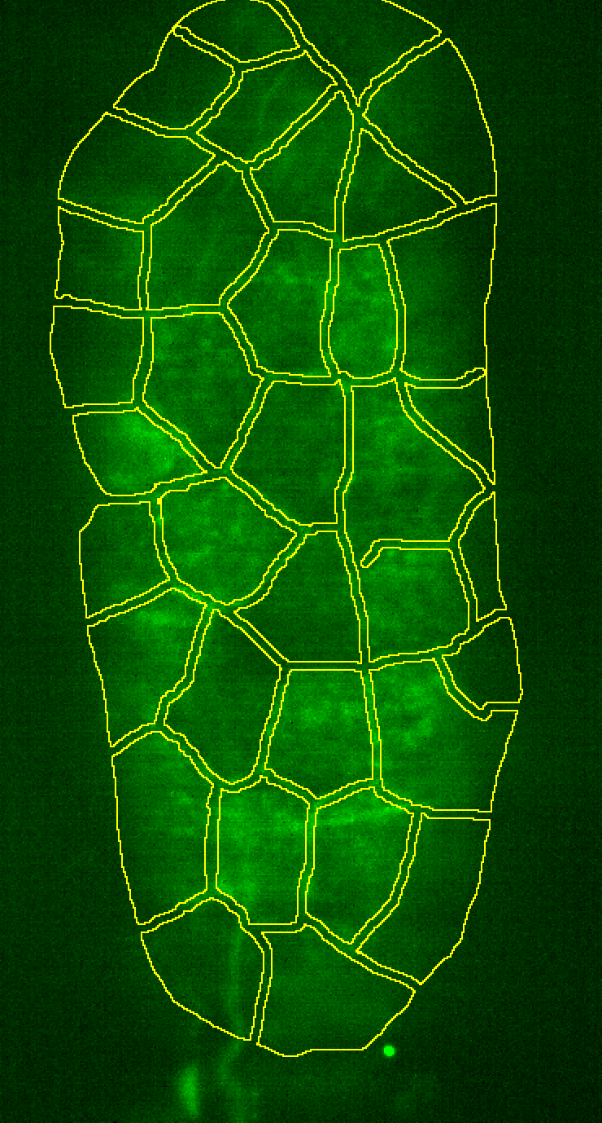
Detection versus Segmentation
3D image segmentation and measurements
Channel for nuclei detection
Points marking nuclei
Nuclei label map
Original image
Resulting segmentation on original image
Channel for cell segmentation
Cell label map
ROIs / outlines
Image source: Akanksha Jain, Tomancak Lab, MPI CBG

Slide 11
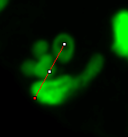
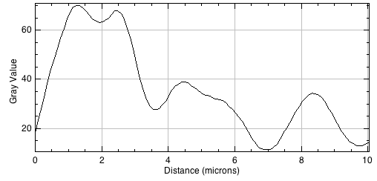
HMaxima detection
3D image segmentation and measurements
If local maxima (bright/dark spots in the image) represent objects of interest/to count, it may be worthwhile to detect local maxima.
If these maxima raise from the background by a certain amount, HMaxima may be the algorithm to go.
Afterwards: Use watershed to segment the objects
h1
h2
h3
h1’
h4
H-maxima principle

Slide 12
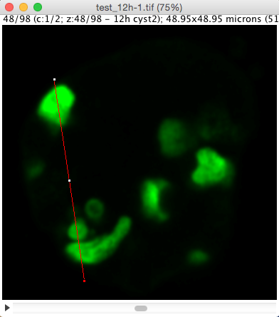
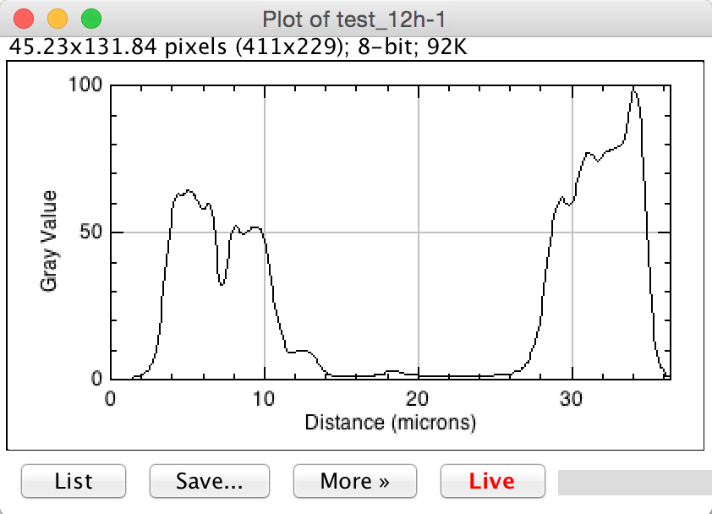
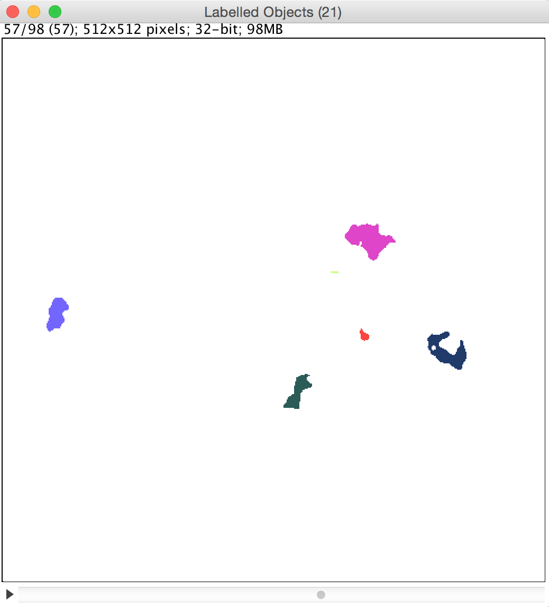
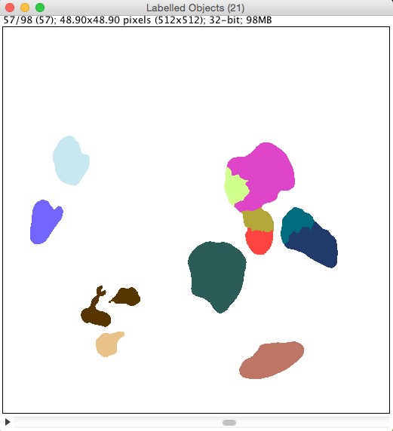
HMaxima detection + Watershed segmentation
3D image segmentation and measurements
DEMO

Slide 13
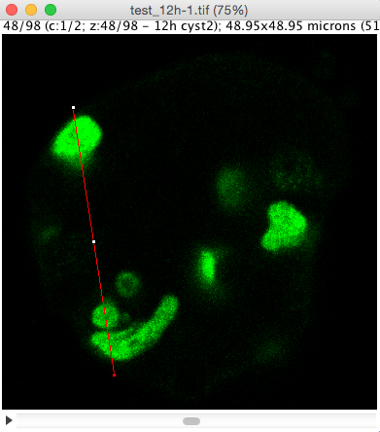
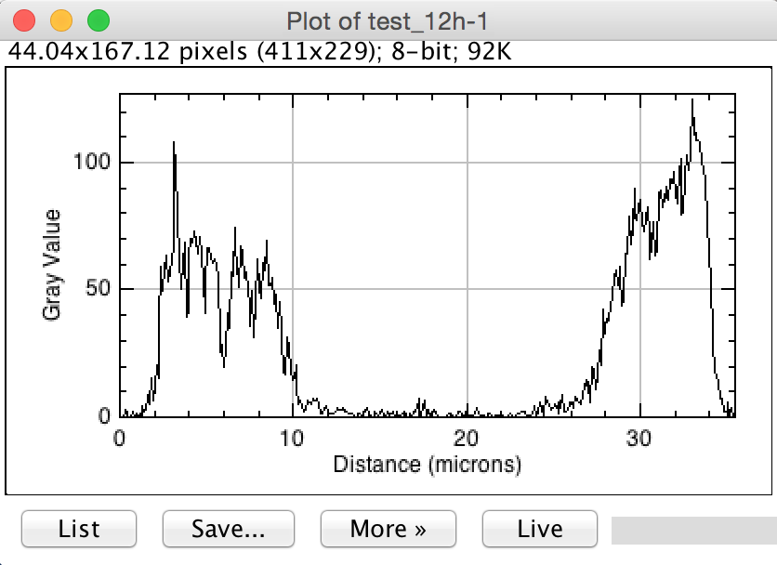
HMaxima based detection
3D image segmentation and measurements
Analyse > Plot Profile
Image source: Elena Gromberg, Tanaka Group, CRTD

Slide 14
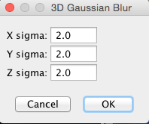
HMaxima based detection
3D image segmentation and measurements
Process > Filters > Gaussian Blur 3D…
Image source: Elena Gromberg, Tanaka Group, CRTD

Slide 15
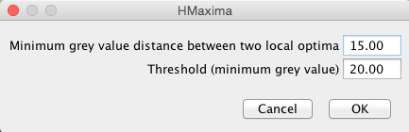
HMaxima based detection
3D image segmentation and measurements
SCF > Labeling> HMaxima local maximum detection…
h_{min}
t_{min}
Image source: Elena Gromberg, Tanaka Group, CRTD

Slide 16
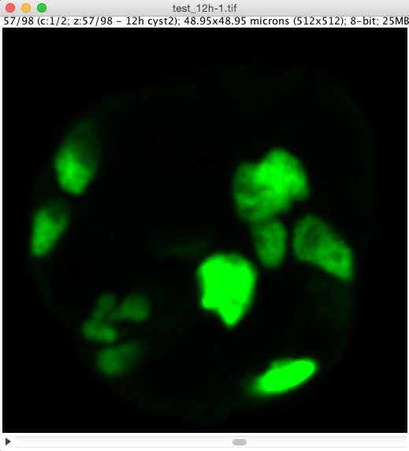
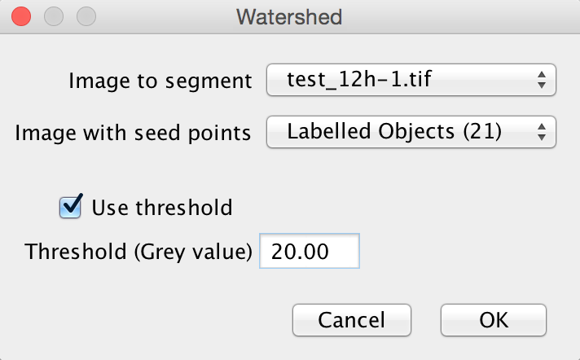
Postprocessing using watershed
3D image segmentation and measurements
SCF > Labeling > Watershed…
Hint: If it’s not displayed correctly, just open the Image > Adjust > Brightness/Contrast dialog

Slide 17
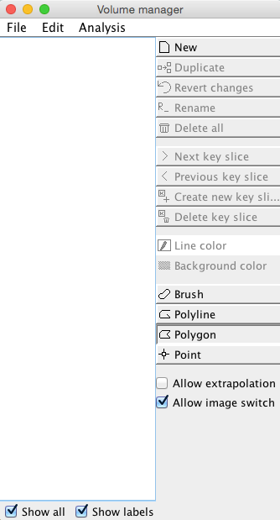
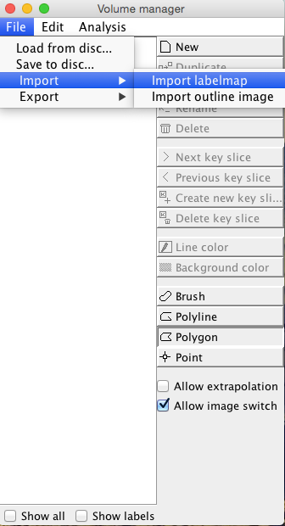
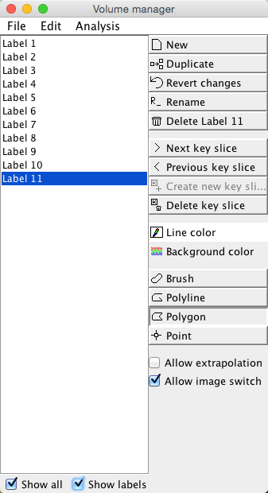
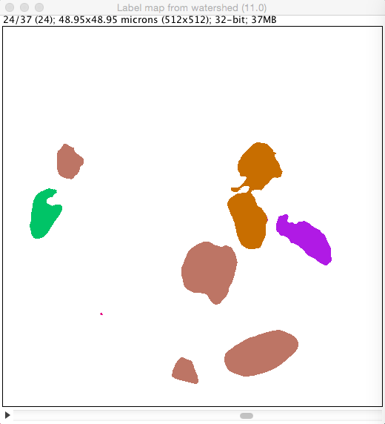
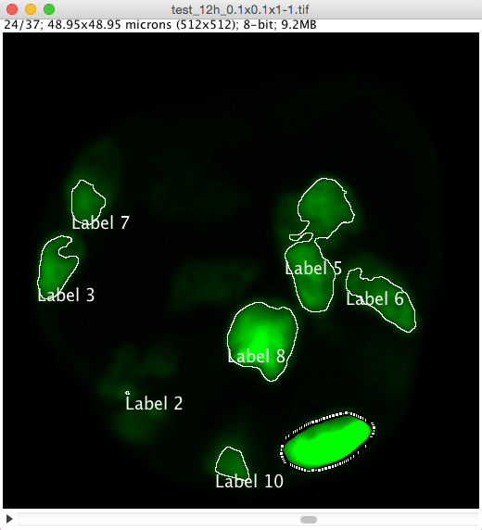
Volume manager
3D image segmentation and measurements
Fiji menu: SCF > Segmentation > Volume manager
Select the label map
Volume manager menu: File > Import > Import labelmap
Switch back to original image

Slide 18
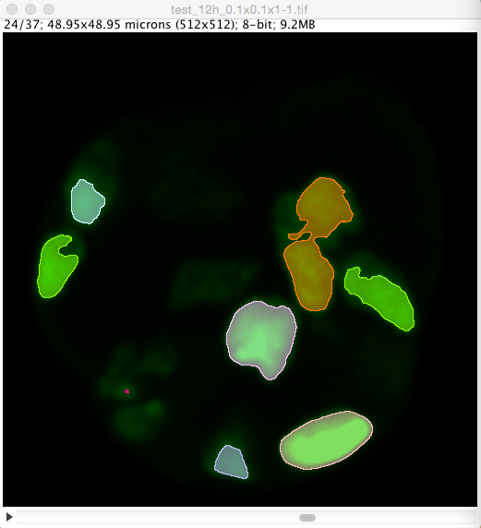
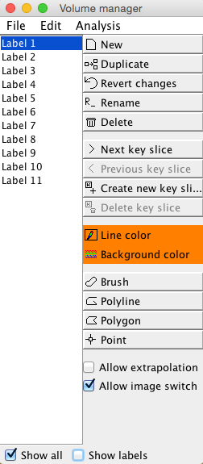
Reslicing resulting label maps
3D image segmentation and measurements
Check the resulting label maps properly – the Gaussian and HMaxima parameters may be improvable!
Use 3D visualisation if needed

Slide 19
Exercise
3D image segmentation and measurements
Open “test_12h_0.1x0.1x0.25.tif”
Try to segment the given data set properly.
How many cells can you differentiate in the green channel?
How did you configure HMaxima to get this number?
16?

Slide 20
Demo: 3D Segmentation in Imaris
3D image segmentation and measurements
Demo

Slide 21
Demo: 3D Segmentation in Imaris
3D image segmentation and measurements
Open a data set from the Arena or by drag&drop

Slide 22
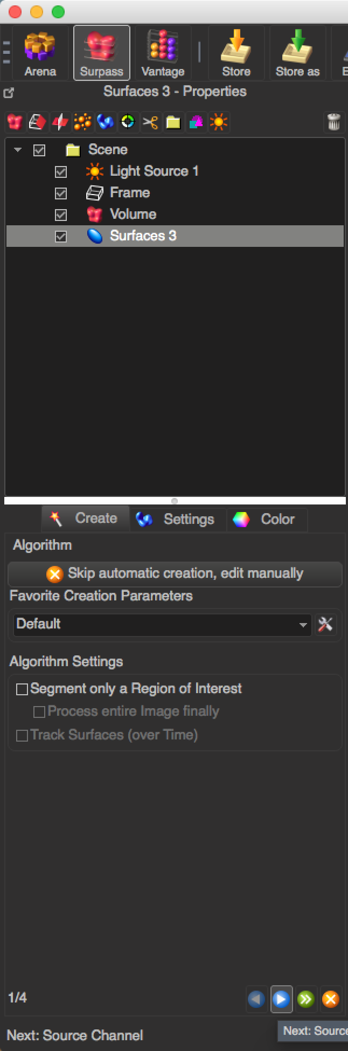
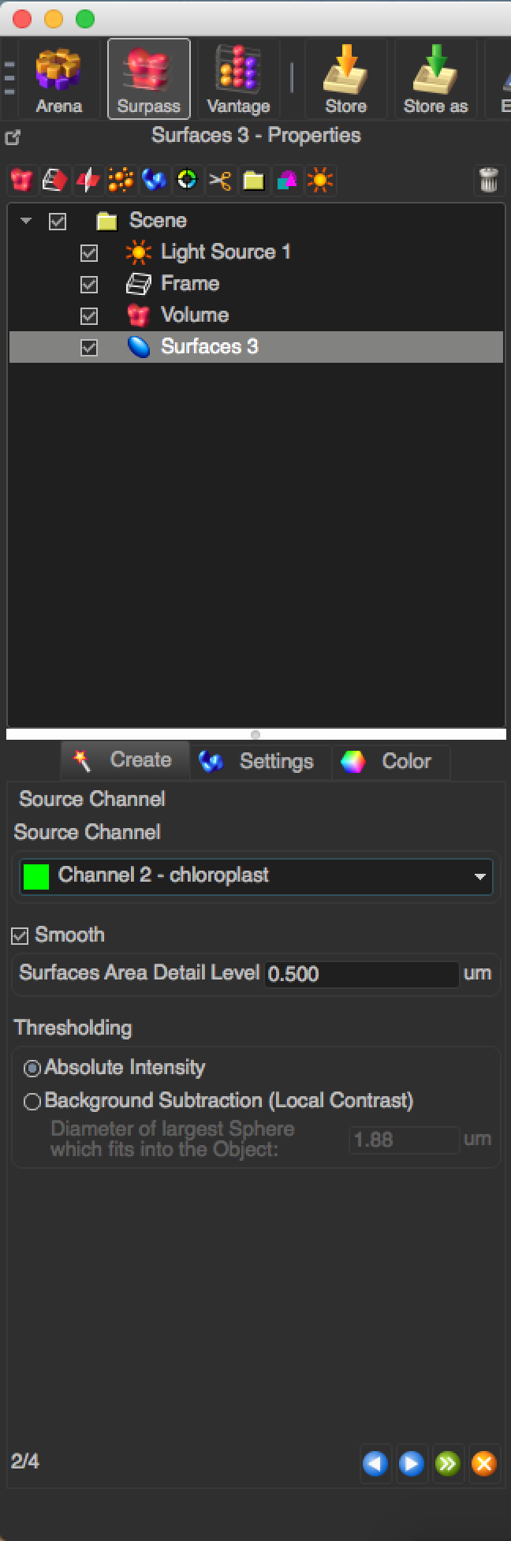
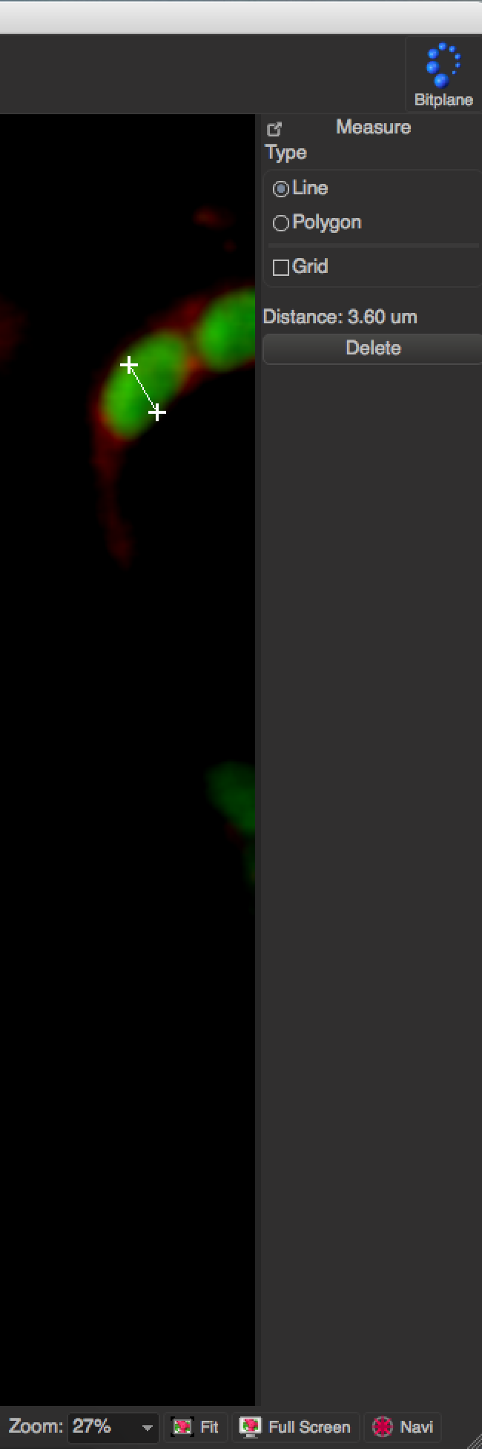
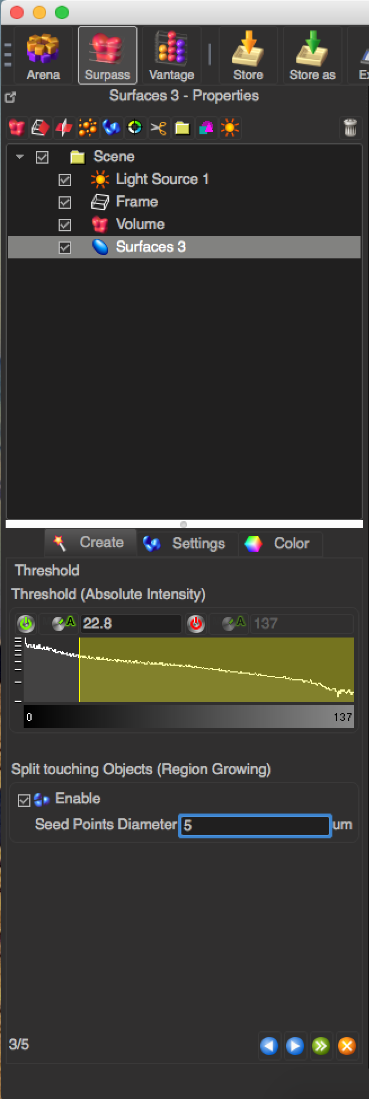
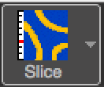
Demo: 3D Segmentation in Imaris
3D image segmentation and measurements
Create a new Surface and follow the instructions in the bottom left corner
Select the channel where the objects are
Switch to view and measure the diameter of one object.
Enter that value as seed points diameter

Slide 23
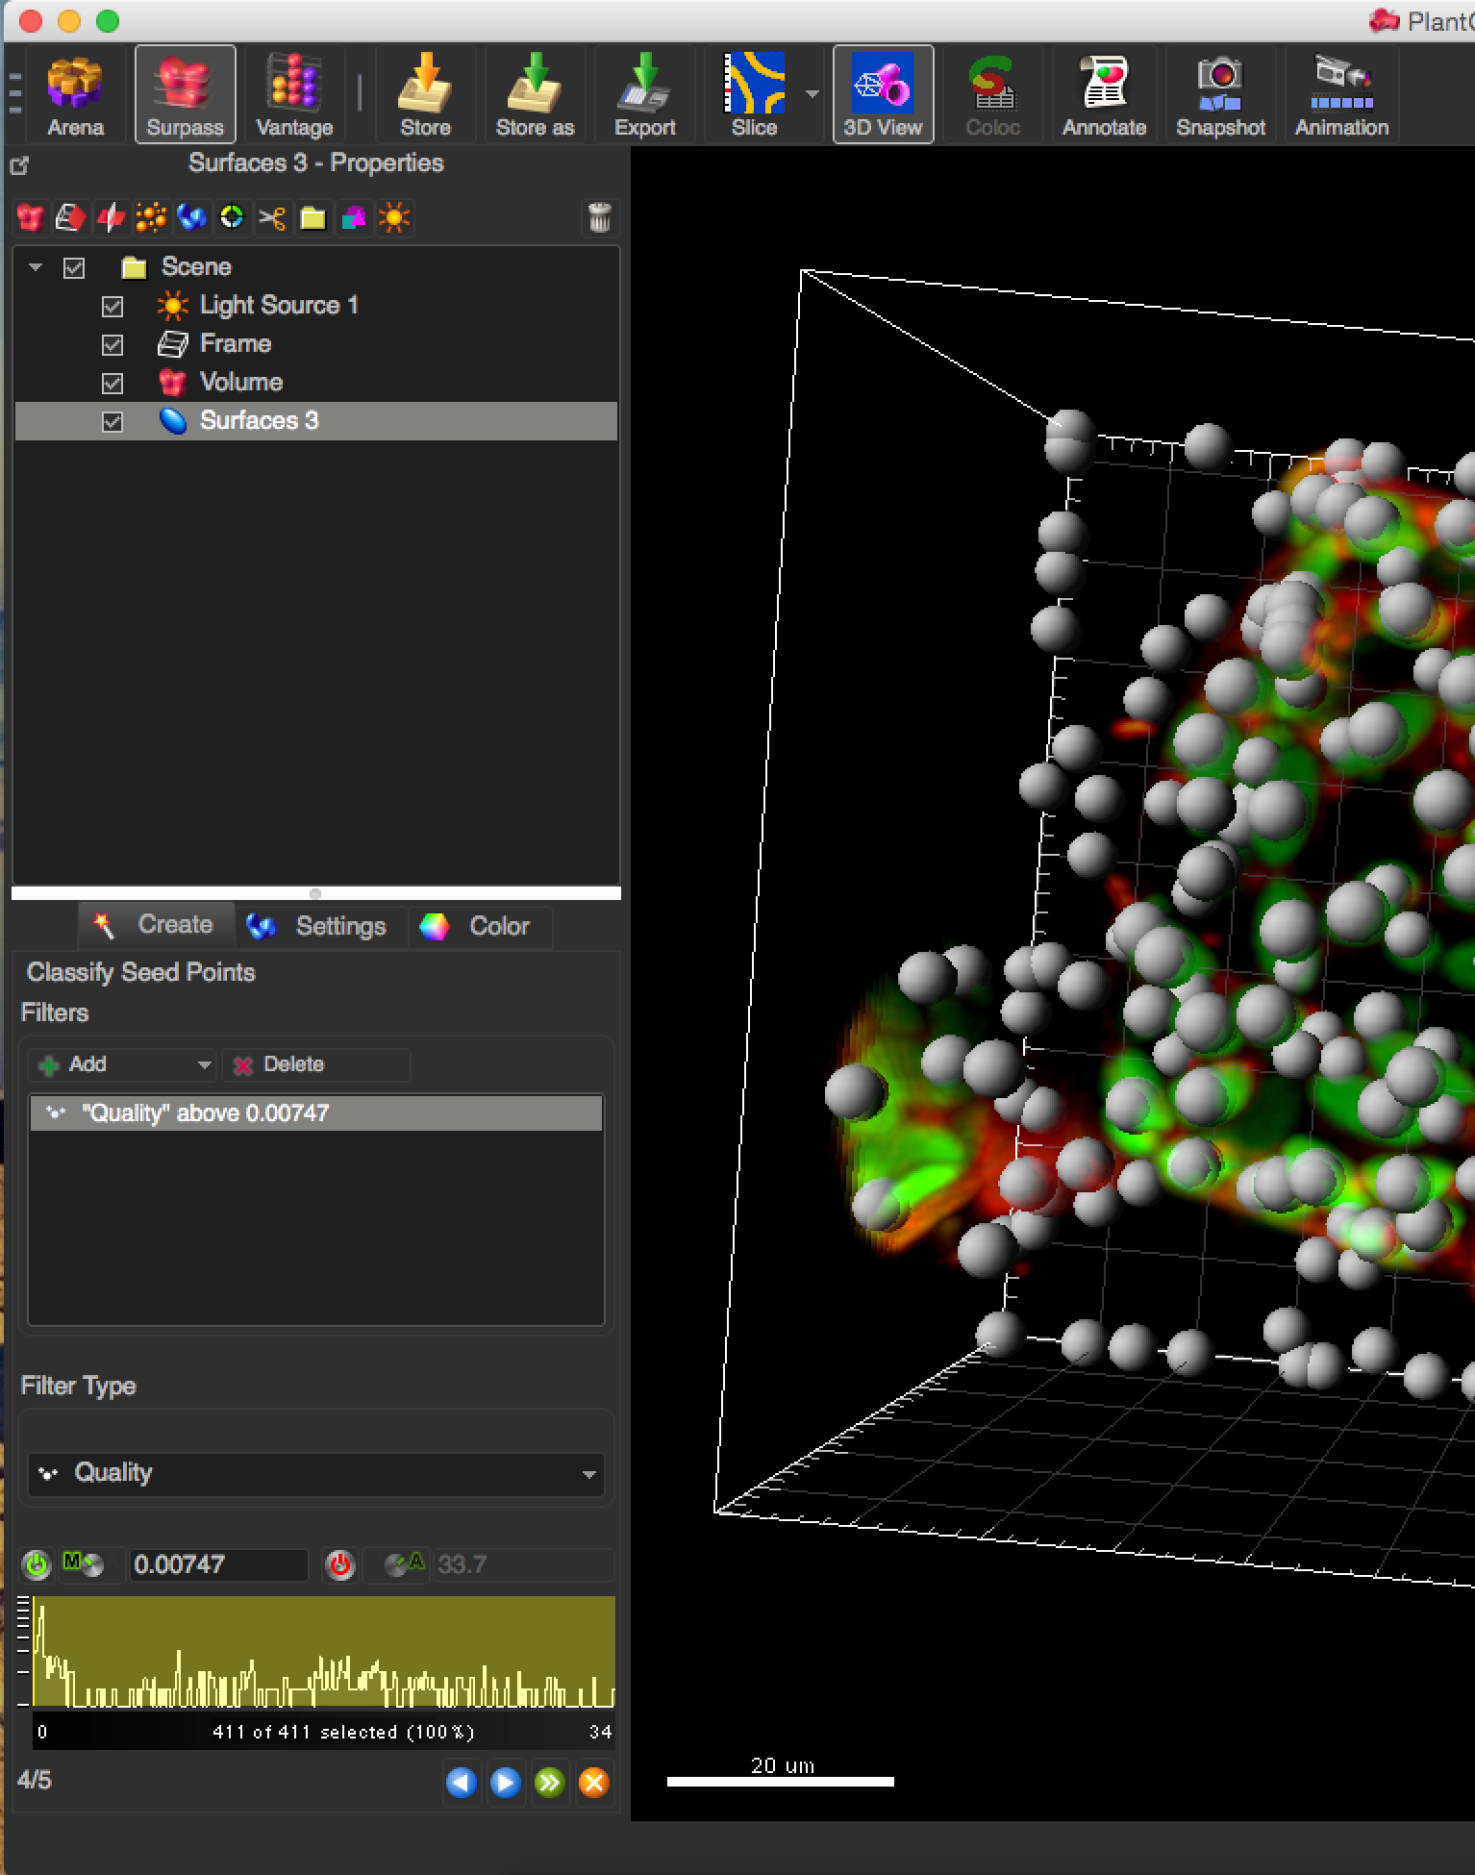
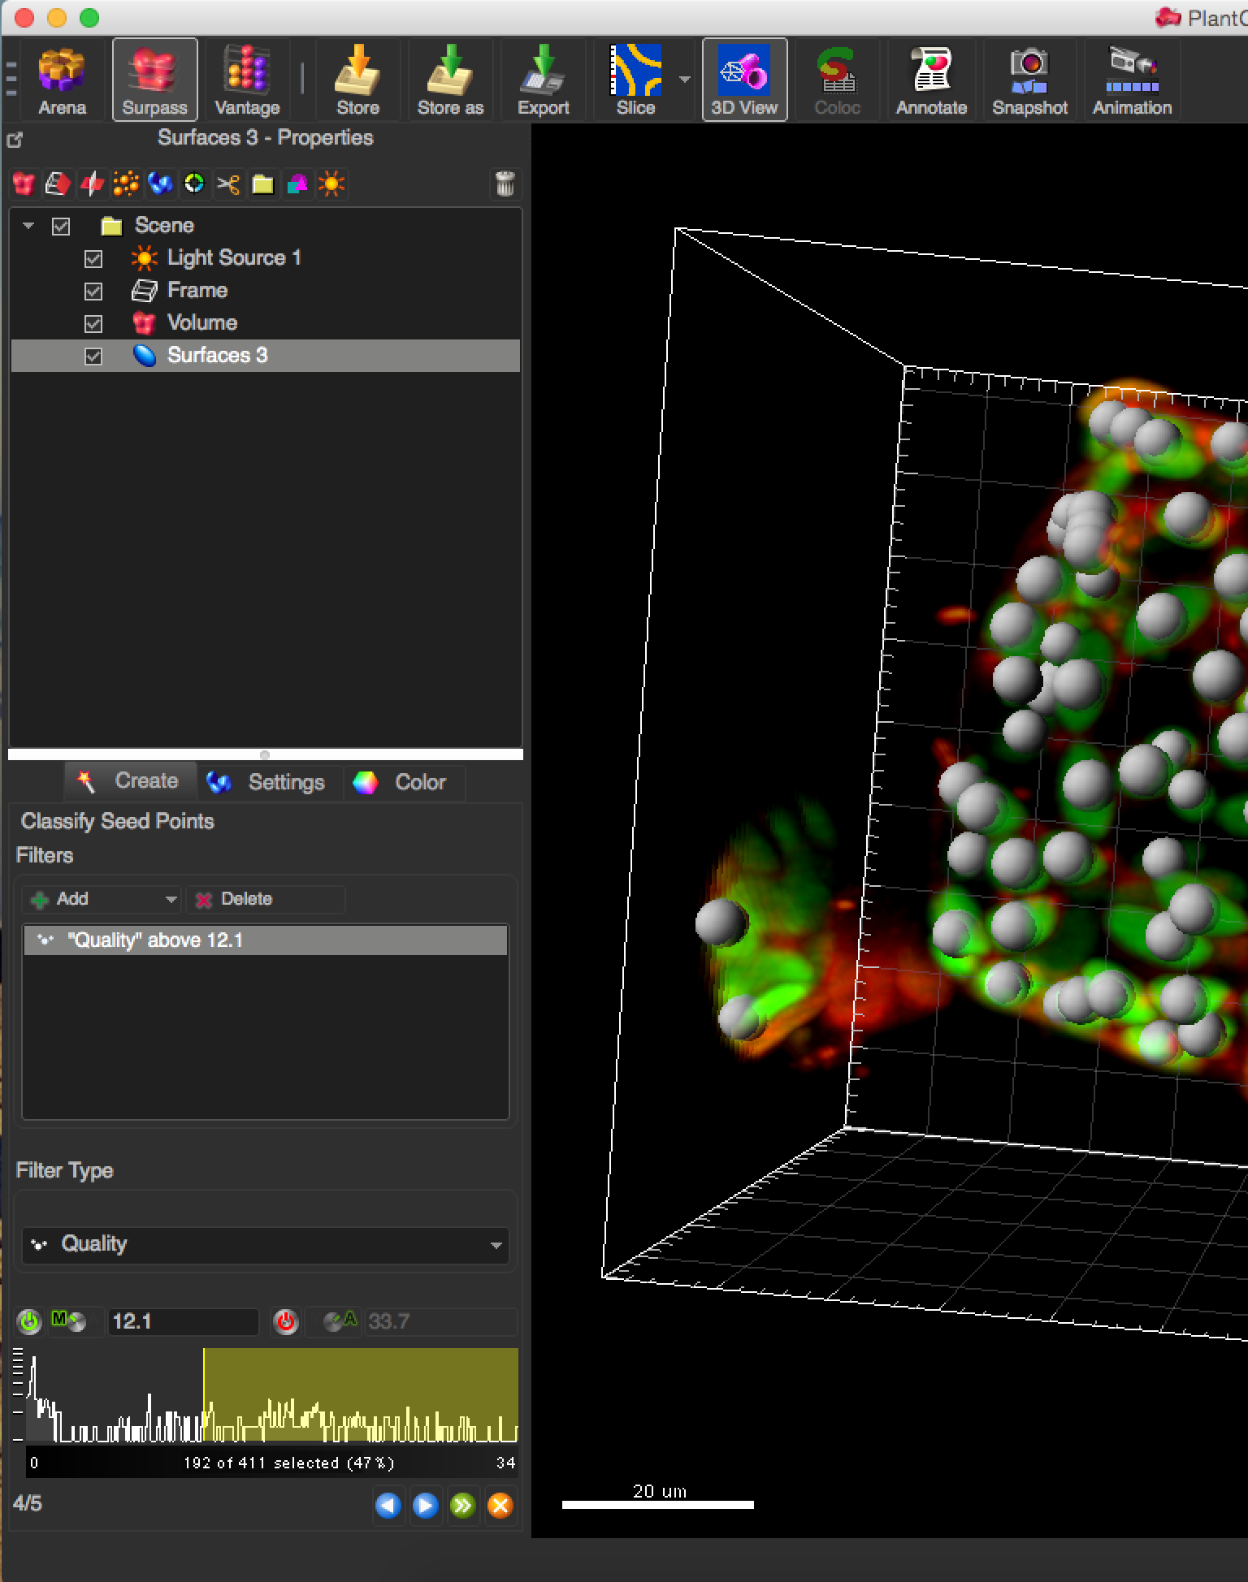
Demo: 3D Segmentation in Imaris
3D image segmentation and measurements
Filter the detected spots by quality

Slide 24
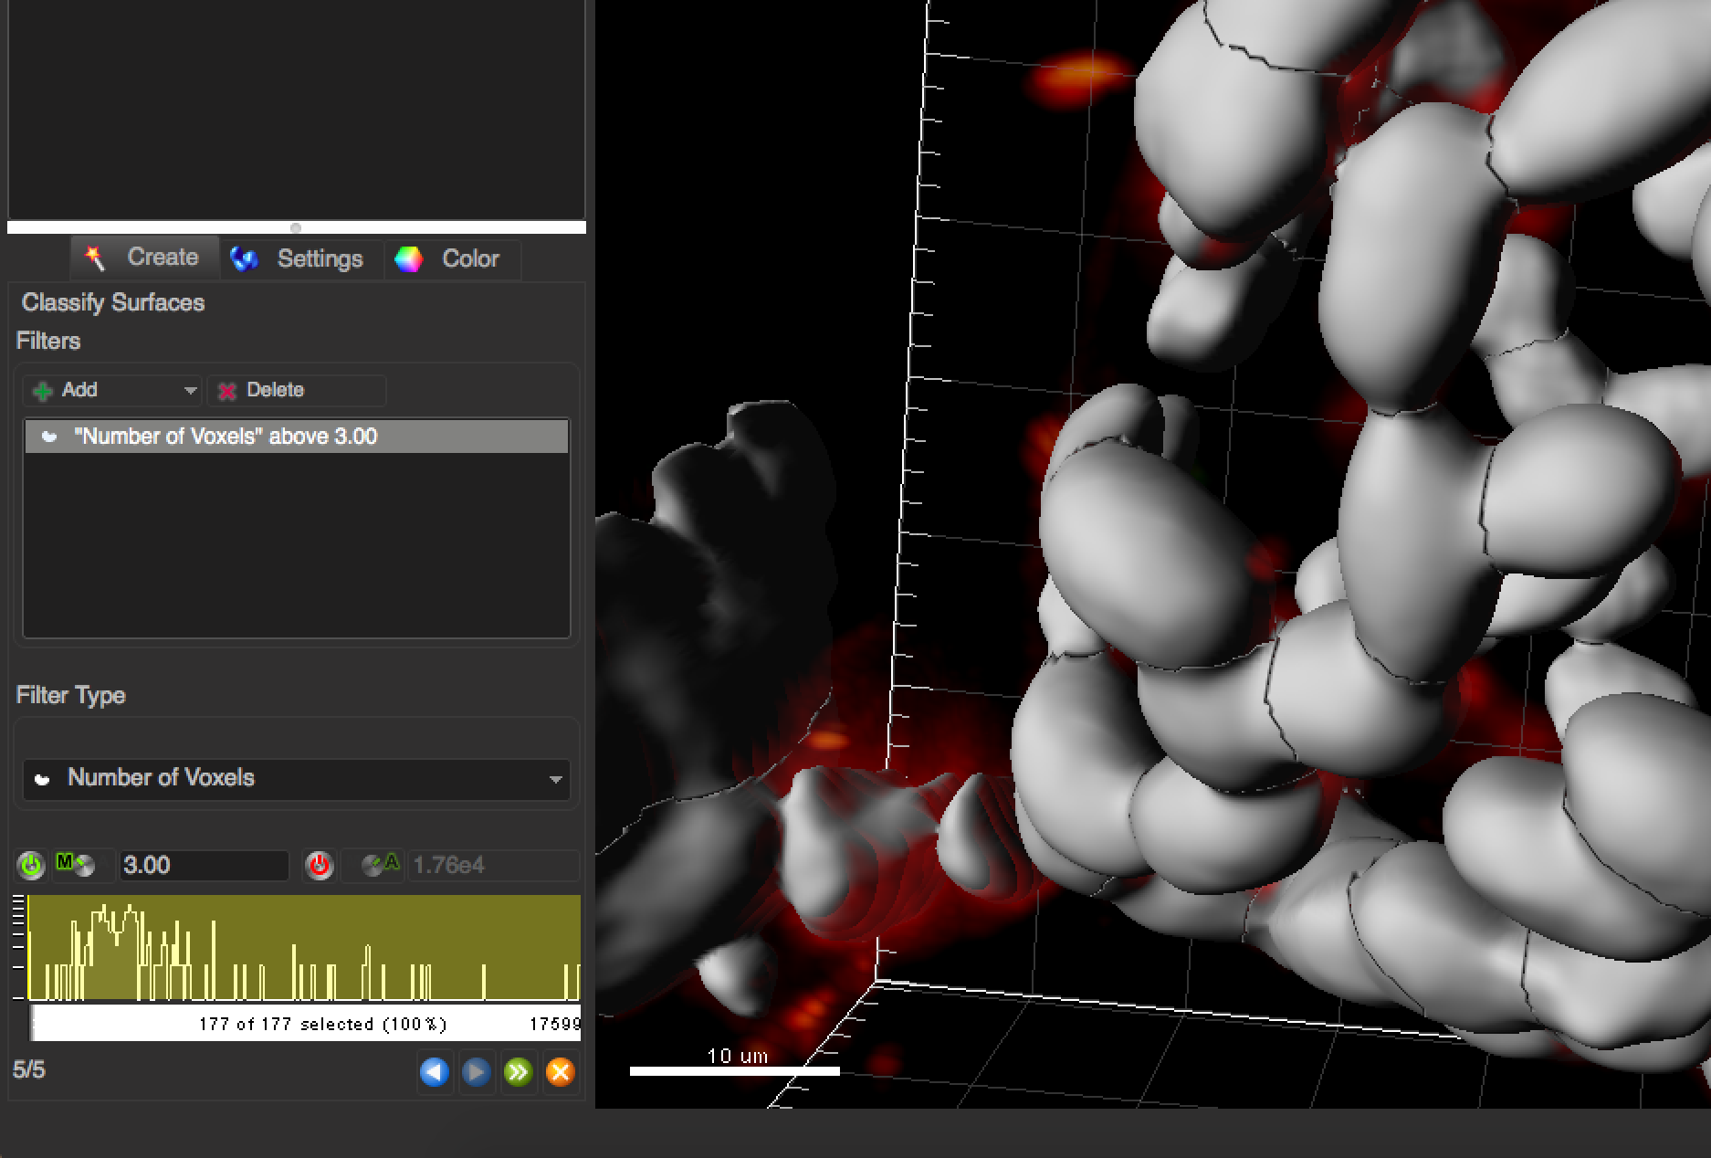
Demo: 3D Segmentation in Imaris
3D image segmentation and measurements
Filter surfaces

Slide 25
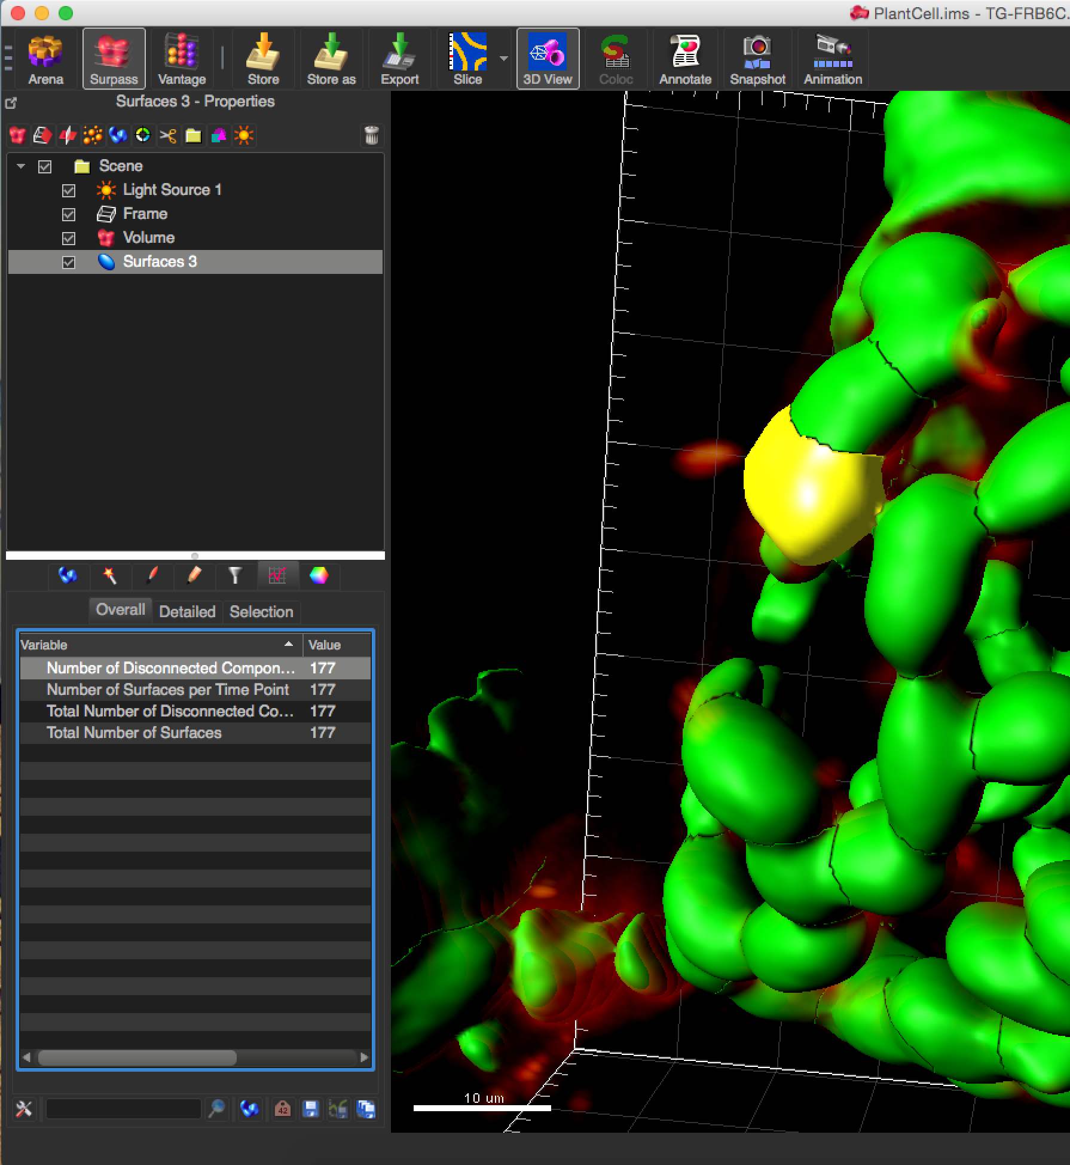
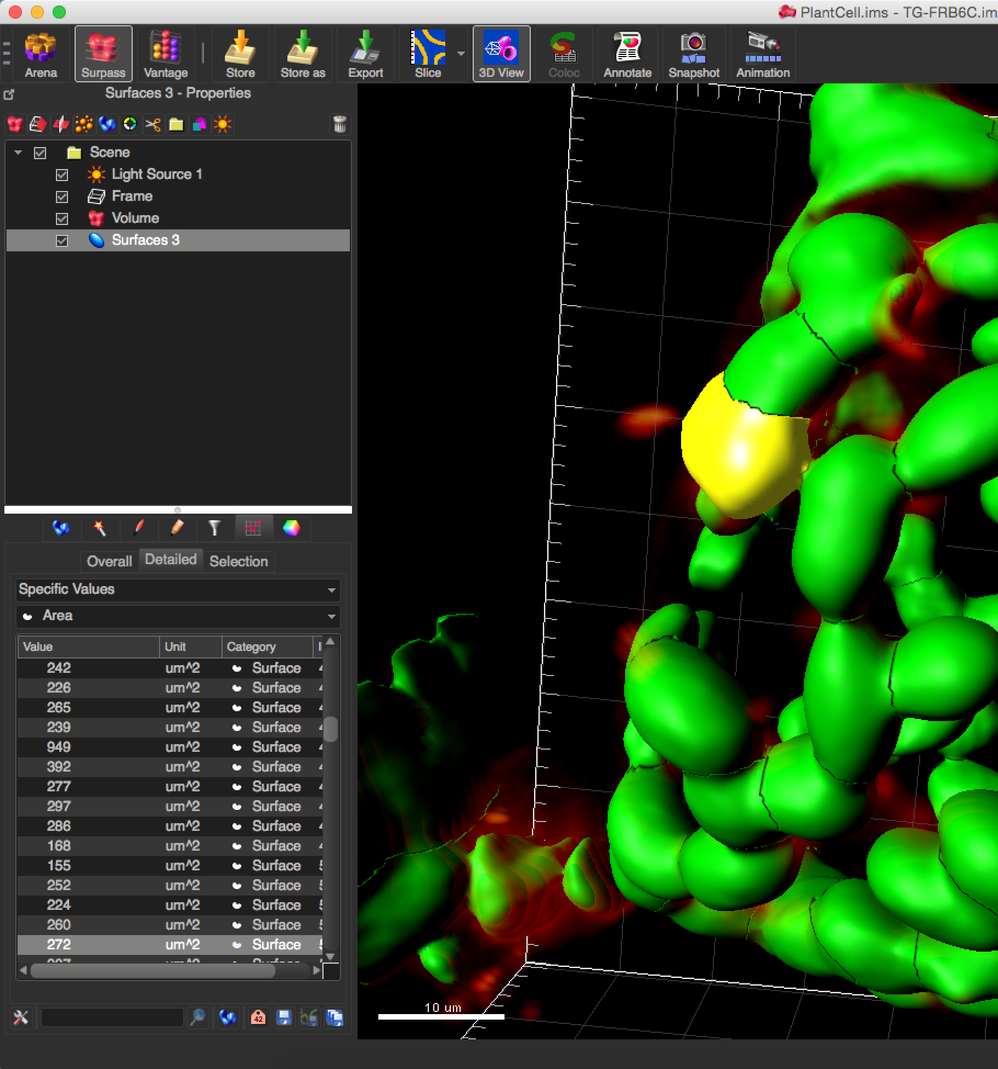
Demo: 3D Segmentation in Imaris
3D image segmentation and measurements
Switch to statistcs view and inspect the individual objects

Slide 26
Overview
3D image segmentation and measurements
Filtering in 3D
Gaussian blur
Segmentation in Fiji
HMaxima
Watershed
Volume manager
Exercise
Segmentation in Imaris
Demo
Measurements in Fiji
Label analyser
Constraint label maps
Exercise
0
11

Slide 27
Measurements in 3D
3D image segmentation and measurements
Obviously, some measurements in 2D and 3D differ:
Area → Volume,
Circularity → Sphericity,
Perimeter length → Surface area
Many others are in principle identical
Mean average signal...
Minimum/maximum signal,
...
Again, tools may be called and work differently:
Particle analyser → Label analyser

Slide 28
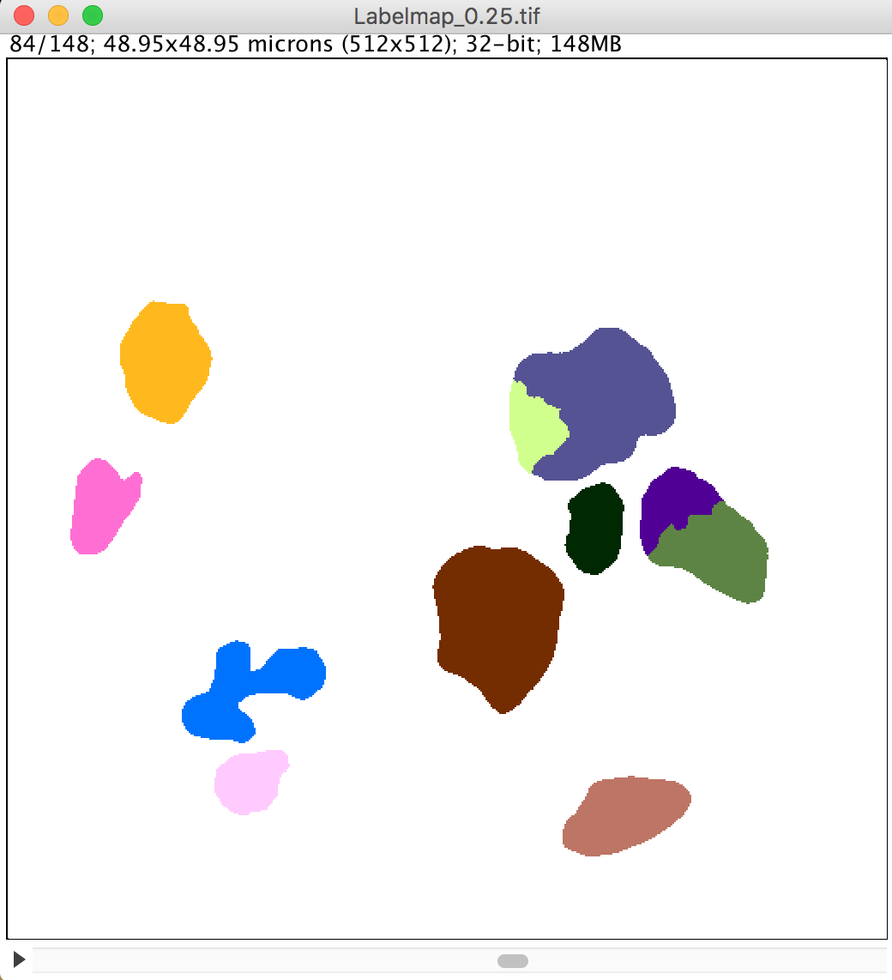



Label analyser
3D image segmentation and measurements
SCF > Labeling > Label Analyser (2D, 3D)

Slide 29




Label analyser
3D image segmentation and measurements
SCF > Labeling > Label Analyser (2D, 3D)

Slide 30
Constraint label map
3D image segmentation and measurements
Typical pipeline extended by:
Constraint or filter resulting object detection/segmentation
By measuring object properties
Detect
Segment
Measure
Constraint
Measure
Find maxima
Watershed
Region growing
Thresholding
Connected components labeling
Particle analyser
Label analyser

Slide 31



Constraint label map
3D image segmentation and measurements
Menu SCF > Labeling > Constraint label map
Constraint minimum volume

Slide 32


Constraint label map
3D image segmentation and measurements
Menu SCF > Labeling > Constraint label map
Constraint minimum and maximum volume

Slide 33

Constraint label map
3D image segmentation and measurements
Constraint for number of neighbours closer than 25 pixels using the label analyser
0
11

Slide 34


Constraint label map
3D image segmentation and measurements
Constraint for number of neighbours closer than 25 pixels using the label analyser

Slide 35
Summary
3D image segmentation and measurements
Apply 3D filters
Detect and segment objects in 3D
Select / constraint objects according to measurements in 3D

Slide 36
Overview
3D image segmentation and measurements
Filtering in 3D
Gaussian blur
Segmentation in Fiji
HMaxima
Watershed
Volume manager
Exercise
Segmentation in Imaris
Demo
Measurements in Fiji
Label analyser
Constraint label maps
Exercise
0
11

Slide 37




Exercise
Exercise: Count nuclei in 3D SPIM data
Unpack the file HisYFP-SPIM.zip
It contains SPIM images of a Drosophila embryo.
Question:
How many nuclei does the embryo consist of?
Image source: https://imagej.net/Multiview-Reconstruction

Slide 38
Exercise: hints
Exercise: Count nuclei in 3D SPIM data
Use multiview-reconstruction to fuse the SPIM measurements in one 3D volume
Use background subtraction to make the nuclei better visible
Use HMaxima and seeded watershed to detect nuclei
Constraint the resulting label map to differentiate actual nuclei and false-positive detections.

Slide 39



Hint: Background subtraction
Exercise: Count nuclei in 3D SPIM data
Process > Subtract background

Slide 40




Hint: HMaxima
Exercise: Count nuclei in 3D SPIM data
SCF > Labeling > HMaxima local maximum detection

Slide 41


Hint: Watershed
Exercise: Count nuclei in 3D SPIM data
SCF > Labeling > Watershed with seed points

Slide 42


Hint: Measure
Exercise: Count nuclei in 3D SPIM data
SCF > Labeling > Label Analyser
What’s a good measure to differentiate cells from false positive detections?

Slide 43


Hint: Constraint labels
Exercise: Count nuclei in 3D SPIM data
SCF > Labeling > Constraint labels in a label map
Constraint for measured label properties

Slide 44



Hint: 3D Viewer
Exercise: Count nuclei in 3D SPIM data
Visualise detection/segmentation

Slide 45


Hint: ClearVolume
Exercise: Count nuclei in 3D SPIM data
Visualise measurements
0
13

